Slide 1
BIA 650
Optimization and Process Analytics 12 – Introduction to Process Mining
Concept and content of workflow logs
Discovering the underlying process
Discovering exceptions
Homework
Copyright. E. A. Stohr, 2017
Notes:
Process mining targets the AUTOMATIC discovery of information from an event log. This discovered information can be used to deploy new systems that support the execution of business processes or as a feedback tool that helps in auditing, analyzing and improving already enacted business processes. The main benefit of process mining techniques is that information is OBJECTIVELY complied. In other words, process mining techniques are helpful because they gather information about what is actually happening according to an event log of a organization, and not what people think that is happening in this organization.

Slide 2
Workflow Management System
Alternate
Jill
Rob
Tom
Kate
John
WF Organization Model
Agents
Clerk
Roles
Manager
Event
Case
WF Process Engine Rules
Data Entry
Approve
OR
Branching rule
Convert $
Reimburse
Archive
External Applications
General Ledger
Database
Notes:
Organizational Model
Roles – that (groups of) actors perform
Security – access rights to data and process activities
Approval authorities – who signs off on what
Organizational hierarchy and substitution policy
Business rules
Process Model
Work routes – time precedence of activities
Processing and branching logic
Triggers, events
Load balancing strategies
External Applications and Databases

Slide 3
Beyond Automation
How can workflow assist management?
Mgt. Role (Fayol & Urwick)
Workflow Function
Planning Coordination of planning & budgeting processes
Organizing Explicit process descriptions, ...
Directing Staff assignments, work load leveling, ...
Coordinating Routing, reminders, streamline hand-offs, ...
Controlling Monitoring performance, managing exceptions, ...
Learning Improve processes, understand customers, ...
Knowledge management
Notes:
Organizing: WF benefit is the documentation and formulation of processes this in turn leads to greater flexibility
Directing: Best person or machine does the work, urgent jobs get done first, parallel concurrent processes
Coordinating: Routing and reminders, work is not lost, the boundaries between functional departments are eliminated, ...
Controlling and learning: Current focus of Cassandra process
So let’s see how this might be done ..

Slide 4
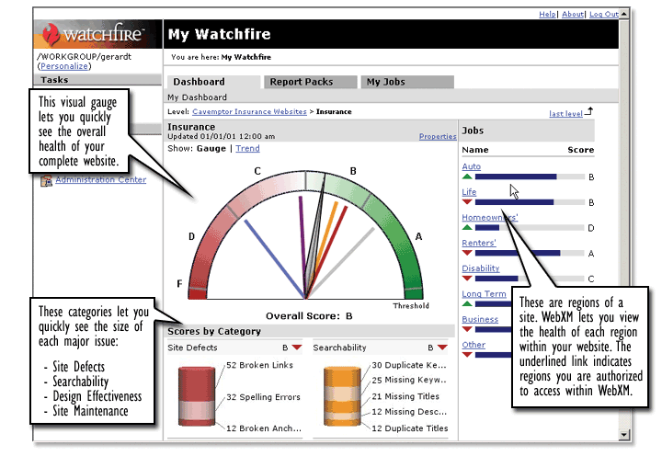
Business Process Controlling
Process goals
Design
Evaluate Process
Implement
Org Database
Process mining
Execute
Corporate Dashboard
Standard reports
Data Warehouse
Monitor in real time
From: Michael zur Muehlen
Workflow Log
Notes:
The four gray objects represent the lifecycle of a workflow project and show the possibility of continuous improvement - “plan do study act”
During the execution phase, the process executes cases, updates its own and external databases and writes to the workflow log. Most systems produce standard reports.
In Cassandra, we are developing an infrastructure and techniques for improving the control process.
“The CEO doesn’t care about systems integration or the concepts of straight through processing, however valid that may be. But the CEO does care about monitoring how the business is performing, being able to react to changes in the market, handling exceptions quickly and effectively, and having a complete view of the organization.” Participant in Howe WF Futures study.

Slide 5
Business Process Monitoring
Order Entry Process
Targets
Maximum cycle time
Average activity times
...
Order Instance (Order # 4711)
(Example from Michael zur Muehlen)
Workflow Log
Process [4711] started [2000-07-31 13:15] by [CC agent]
Activity [1] ready [2000-07-31 -13:15]
Activity [1] started [2000-07-31 -13:17] by [CC agent]
Activity [1] completed [2000-07-31 -13:31] by [CC agent]
Activity [2] ready [2000-07-31 -13:32]
Activity [2] started [2000-07-31 -13:40] by [5121]
Activity [2] completed [2000-07-31 -14:05] by [5121]
Process [4711] finished [2000-07-31 -14:06]
……..
2
3
1
1
Idle time
2
Processing time
3
Cycle time
Notes:
Let’s start with the basics and look at what information we can get from the log ..
Order Entry Process - some desired performance measures
There may be 1000’s of orders each day, each is an instance of the process - here we look at the log for order #4711
From the start and end times of each activity, we can easily determine the idle time processing time and cycle time for this instance of the process
and this gives us a chance to

Slide 6
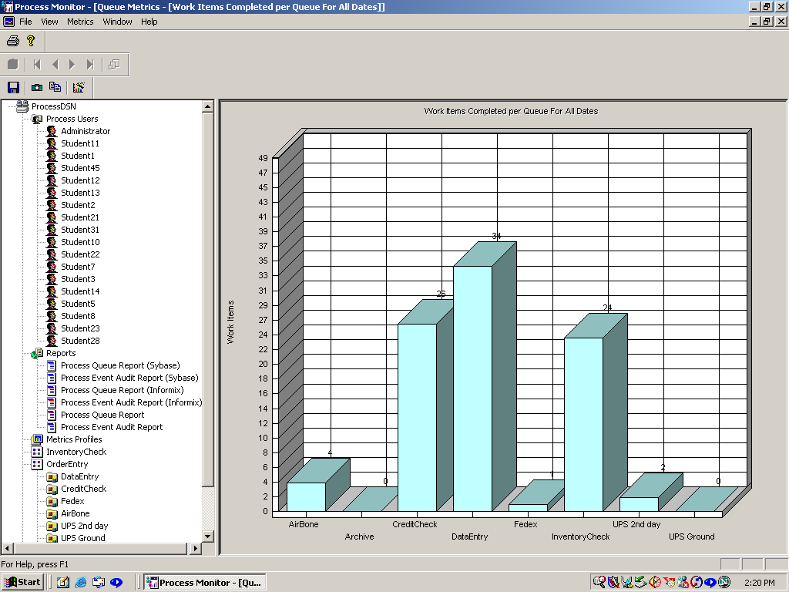
Monitoring Work Queues in Real Time
Notes:
Load balance by assigning additional personnel electronically to bottleneck activities where queue sizes are large - all that happens is that change roles so that they receive a different kind of work
Note that this could be done in a paper-based system by observing the sizes of the piles of paper in in-trays ..

Slide 7
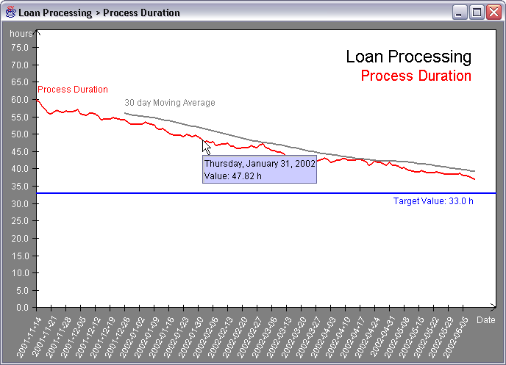
Process Improvement
(Example from Michael zur Muehlen)
Notes:
If we track process performance over time, we might get a graph like this ..

Slide 8
Process Quality Control
Claim Exceptions
Out of control?
9.5%
9.0%
8.5%
8.0%
Proportion of Exceptions
7.5%
7.0%
6.5%
6.0%
Mon
Tue
Wed
Thu
Fri
Sat
Sun
Weekday
Mean
Prop_bad
Notes:
By determining from the workflow log the relative number of cases that end up in special exception handling steps, we can use standard flow charting techniques to test if the process is in statistical control or if something systematic has occurred to throw the system out of balance:
A new operator that needs training A major supplier is sending us inaccurate data More complex cases are occurring The volume of work is causing human error

Slide 9
Process Mining
Workflow Log
Data Warehouse
Process [4711] started [2000-07-31 13:15] by [CC agent]
Activity [1] ready [2000-07-31 -13:15]
Activity [1] started [2000-07-31 -13:17] by [CC agent]
Process Mining Software
Process analysis
Discover the underlying process structure (map)
Isolate and understand exception cases
Perform customer profile analysis
Insert new knowledge into process steps
Notes:
All of the above is fairly straight forward. The research questions are not so much how to do it, but rather how useful this kind of controlling will be in practice? And what are the behavioral implications? How do you develop good incentive schemes?
Finally, we can direct the output of the workflow log to a data warehouse and do some data mining:
Some of the things we can do now are:
Discover the process map. This is useful when the workflow system is turned on but people are allowed to decide how documents should be routed. This can be a useful implementation technique because it means that you are not forcing process change on people.
Understand why exceptions occur - this might require connecting the events in the workflow log to the real data that is being processed. This is beyond the capability of most workflow systems at the current time - the problem is examined in Michael zur Muehlen’s thesis.
Once this linkage has been achieved, one can then perform customer profile analysis, for example - to find out which classes of customer take the most processing time or or produce the most processing errors
Finally, the new knowledge about work can be fed back into the system so that when, for example, a new claim is to be processed, the system can check to see how a previous claim

Slide 10
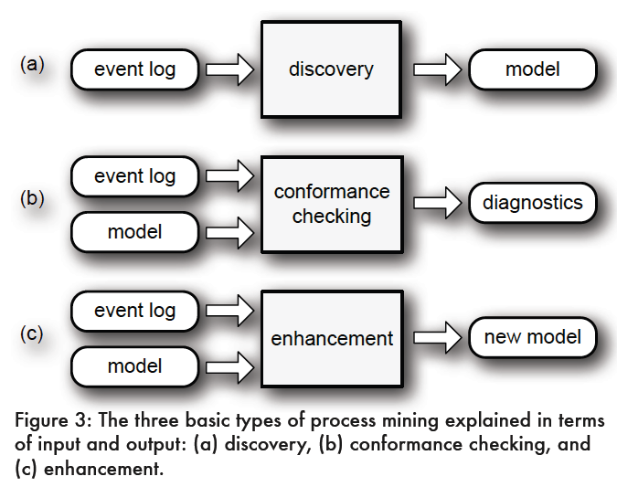
Three Types of Process Mining
Notes:
Event logs can be used to conduct three types of process mining.
The first type of process mining is DISCOVERY. A discovery technique takes an event log and produces a model without using any a-priori information.
Conformance checking can be used to check if reality, as recorded in the log, conforms to the model and vice versa.
After conformance checking measures the alignment between model and reality, this third type of process mining aims at improving or extending an existing process model using information about the actual process recoded in some event log.

Slide 11
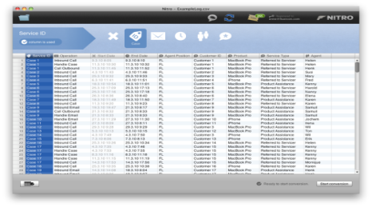
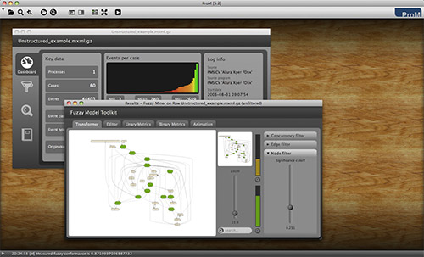

Event Log Construction
Input data needs to be mapped onto event sequences in MXML
Fluxicon’s tool Nitro makes this easy
.csv file
NITRO
.MXML file
PROM
CSV
Data
Event
Log
Download from www.promtools.org/prom5/
Download from fluxicon.com/nitro
NEW!
Download DISCO from http://www.fluxicon.com.
The new version of DISCO combines these steps.

Slide 12
Sample Event Log (Excel)
Case ID | Operation | Start Date | End Date | Customer ID | Product | Agent
Case 1 | Dentry | 9.3.10 8:05 | 9.3.10 8:10 | Customer 1 | Widget | Helen
Case 1 | ChkInv | 9.3.10 8:12 | 9.3.10 8:17 | Customer 1 | Widget | Helen
Case 1 | Send | 9.3.10 8:20 | 9.3.10 8:30 | Customer 1 | Widget | Helen
Case 1 | Close | 9.3.10 8:30 | 9.3.10 8:35 | Customer 1 | Widget | Helen
Case 2 | Dentry | 9.3.10 8:40 | 9.3.10 8:45 | Customer 2 | Widget | Helen
Case 2 | ChkInv | 9.3.10 8:45 | 9.3.10 8:50 | Customer 2 | Widget | Helen
Case 2 | Send | 9.3.10 8:55 | 9.3.10 8:60 | Customer 2 | Widget | Helen
Case 2 | Close | 9.3.10 8:65 | 9.3.10 8:70 | Customer 2 | Widget | Helen
Case 3 | Dentry | 9.3.10 8:20 | 9.3.10 8:25 | Customer 3 | Gidjet | George
Case 3 | ChkCred | 9.3.10 8:30 | 9.3.10 8:35 | Customer 3 | Gidjet | George
Case 3 | Send | 9.3.10 8:40 | 9.3.10 8:45 | Customer 3 | Gidjet | George
Case 3 | Close | 9.3.10 8:50 | 9.3.10 8:55 | Customer 3 | Gidjet | George

Slide 13
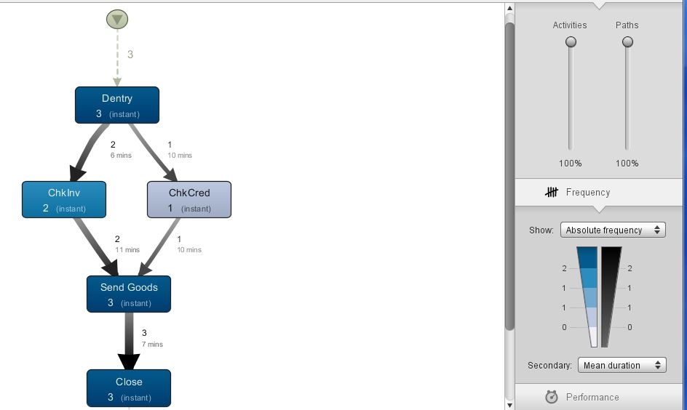
Process Map
The process mining algorithm has successfully identified the process map
Use these sliders to show more or less detail
1 case on this path ;
10 minutes duration
Helen
Can display different statistics

Slide 14
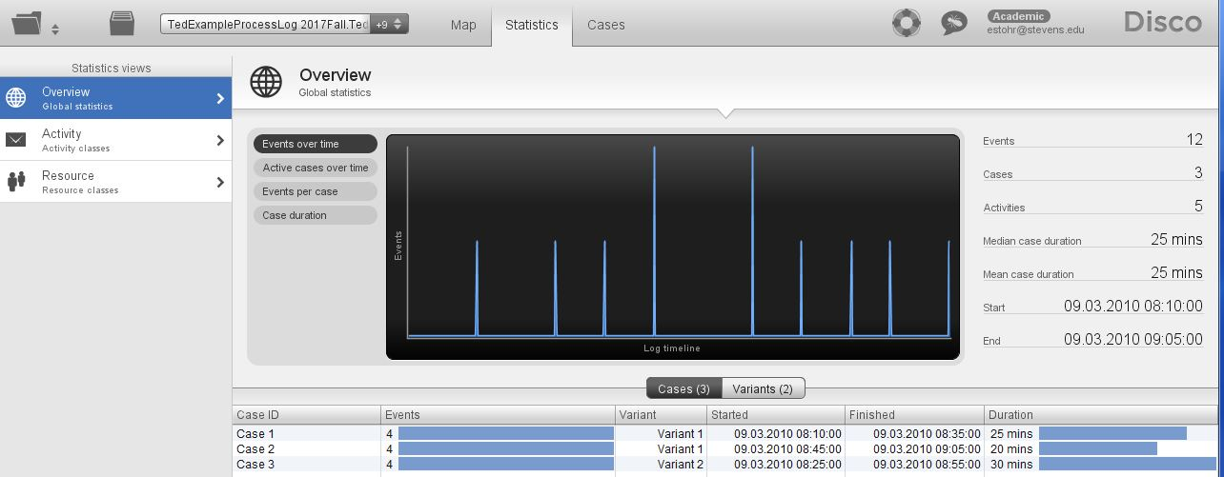
Stats – Events over Time

Slide 15
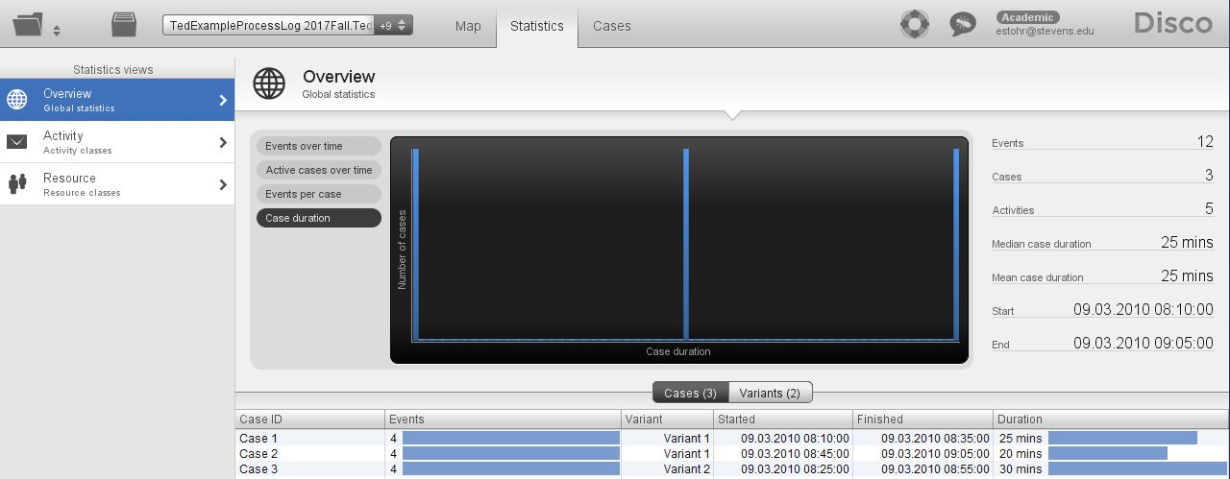
Stats - Case Duration

Slide 16
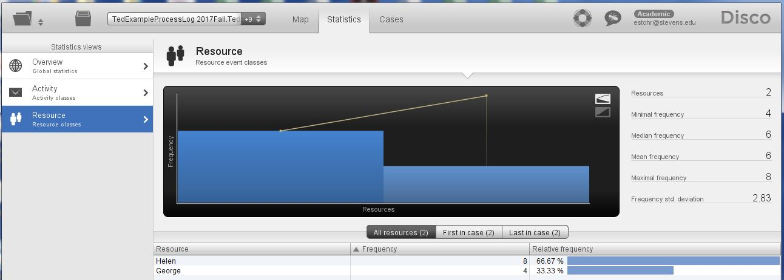
Stats - Resource Usage
Helen
George

Slide 17
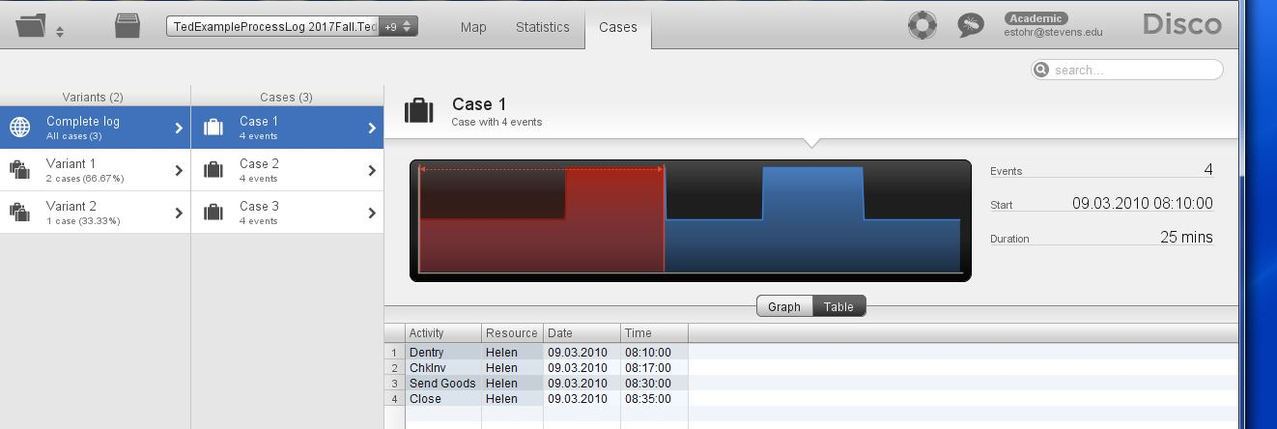
Log of Cases

Slide 18
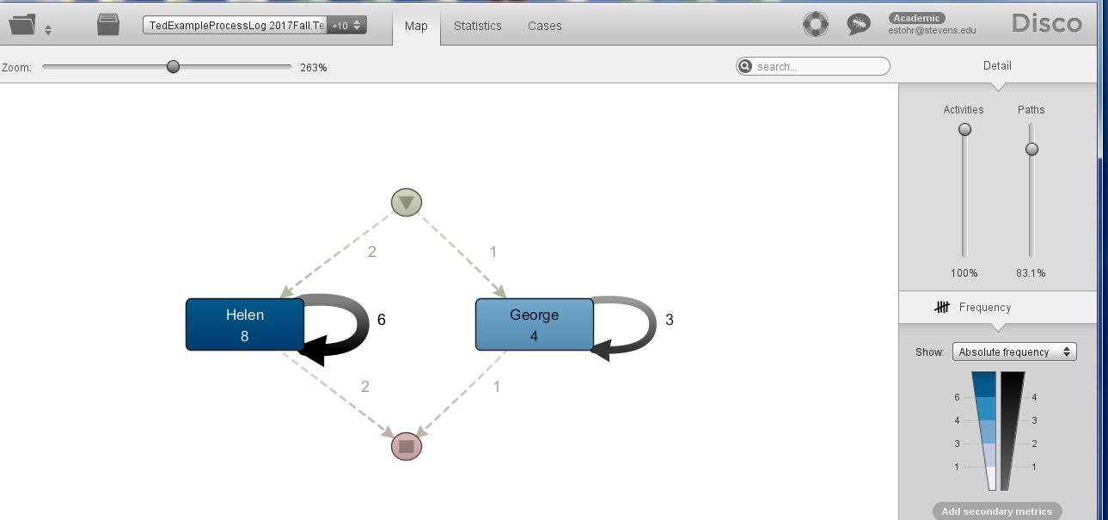
Social Network
To get this view identify the Actors as Activities

Slide 19
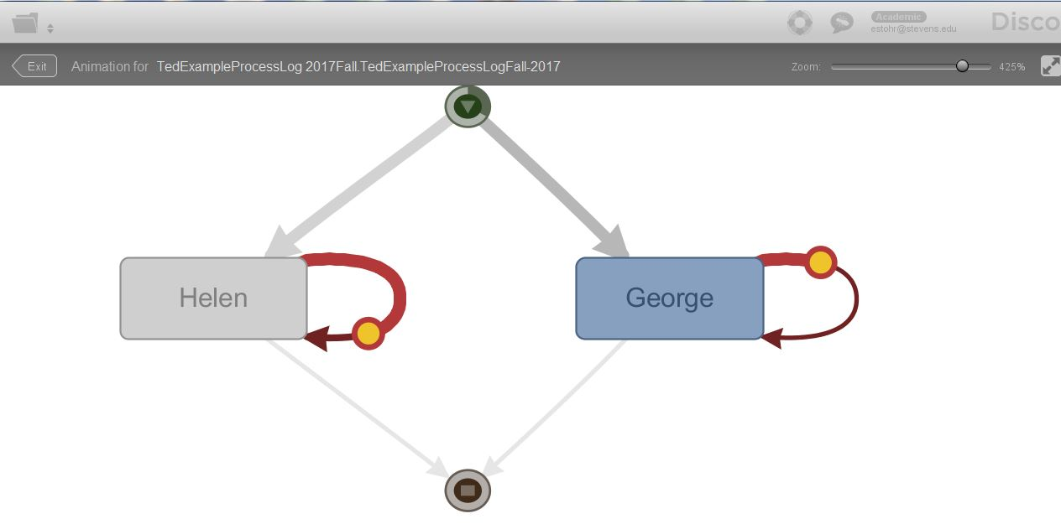
Animation of Social Network

Slide 20
Animation of Social Network

Slide 21
Sample Call Center Problem
Call Center
Front Line
Back Line
Customers
CRM System

Slide 22
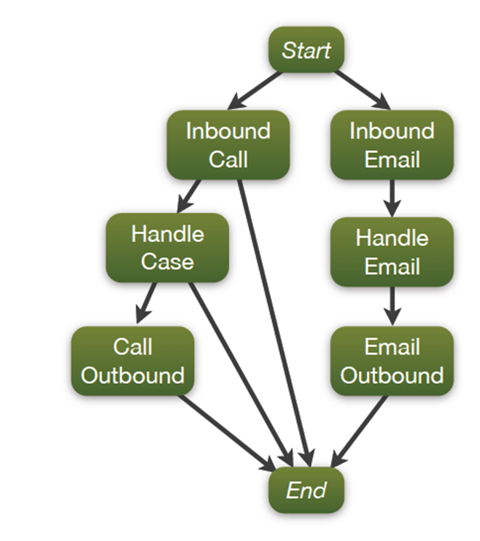
Expected Process
Problem
Increased costs:
- More activities
- Lower first call resolution rate
Decreased customer satisfaction:
- Net promoter score (NPS) 5
Expected
Process

Slide 23
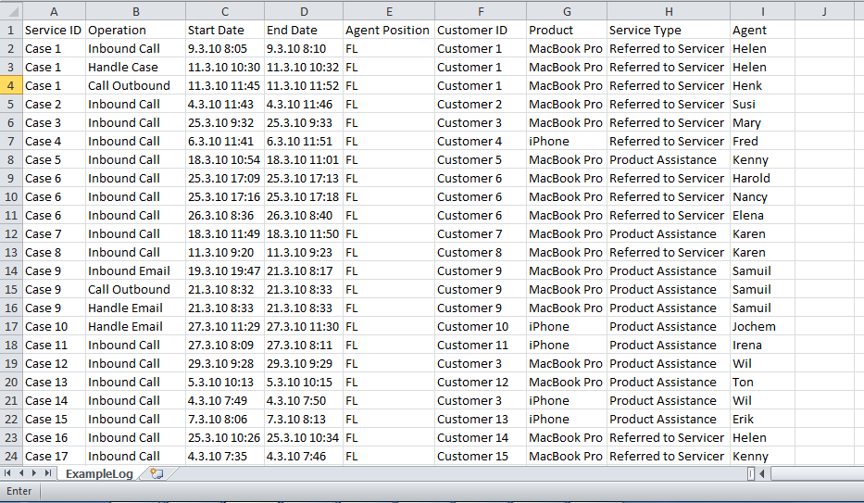
Inspect Data

Slide 24
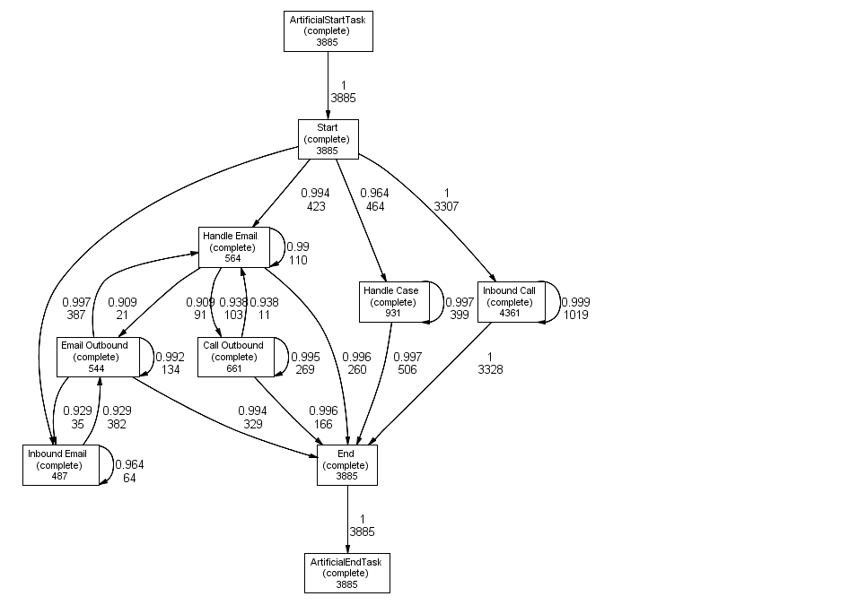
Call Center Case: Compare Actual Process
Notes:
Compare the actual process with the expected process,
The actual process does not always start with calls or emails.
We want to see whether quality problem is in front line or back line.

Slide 25
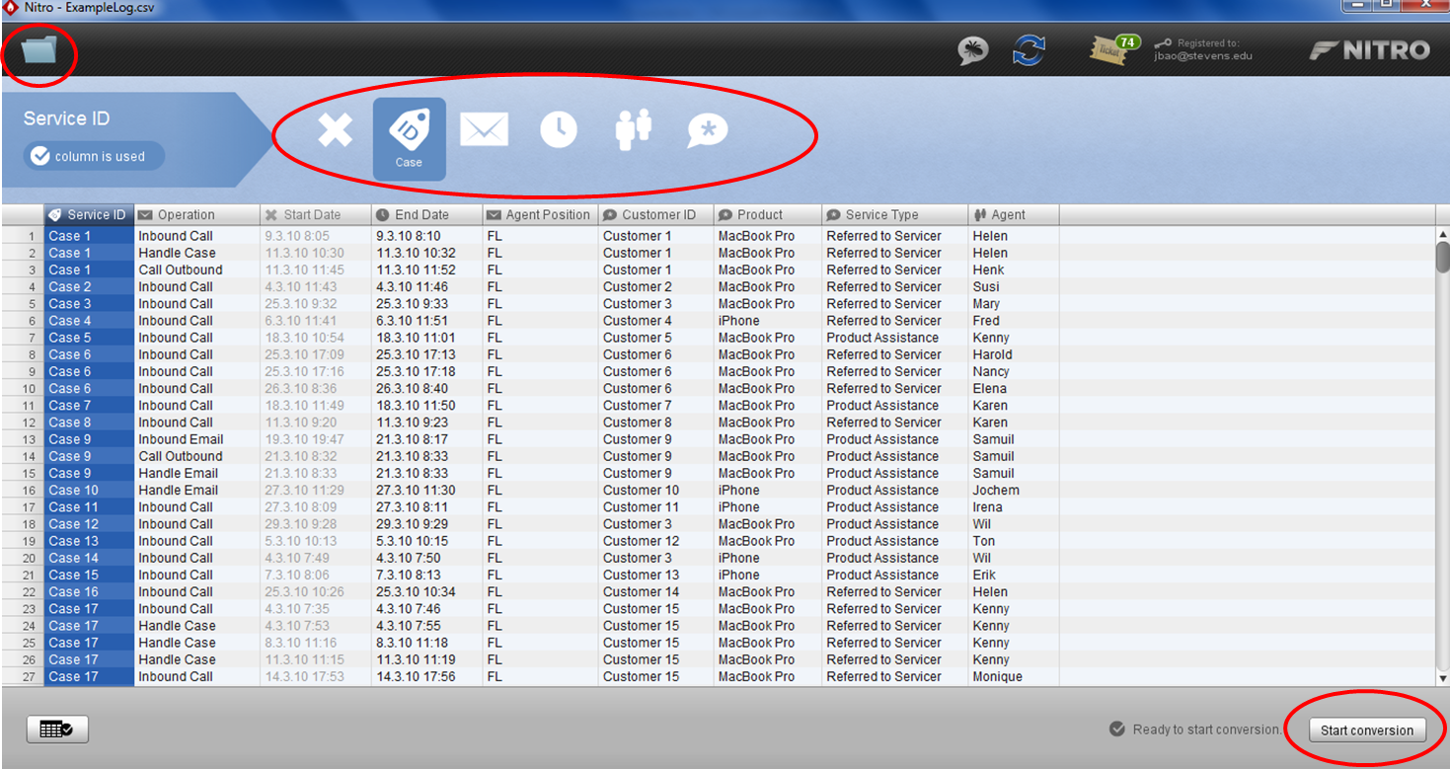
Construct Log
Associate the columns in the input file with the components of the workflow model. (The ID for the cases is in column 1, for example.)
Click here to initiate the process mining algorithm.

Slide 26
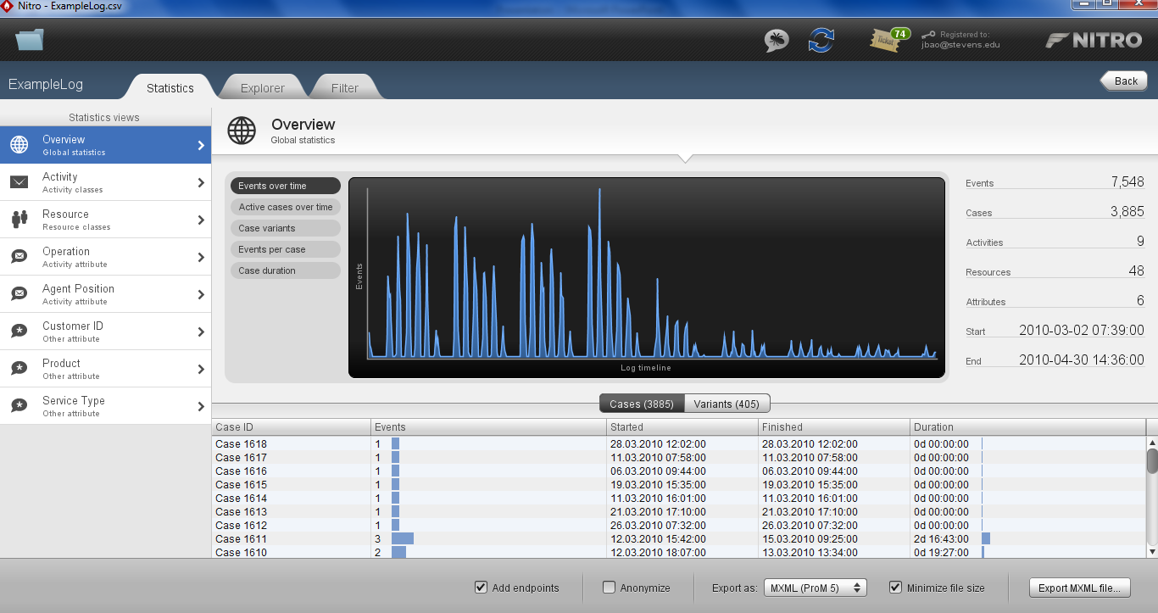
Inspect Log – Various Graphs and Statistics
Here we see a frequency chart of the events that occur over time.

Slide 27
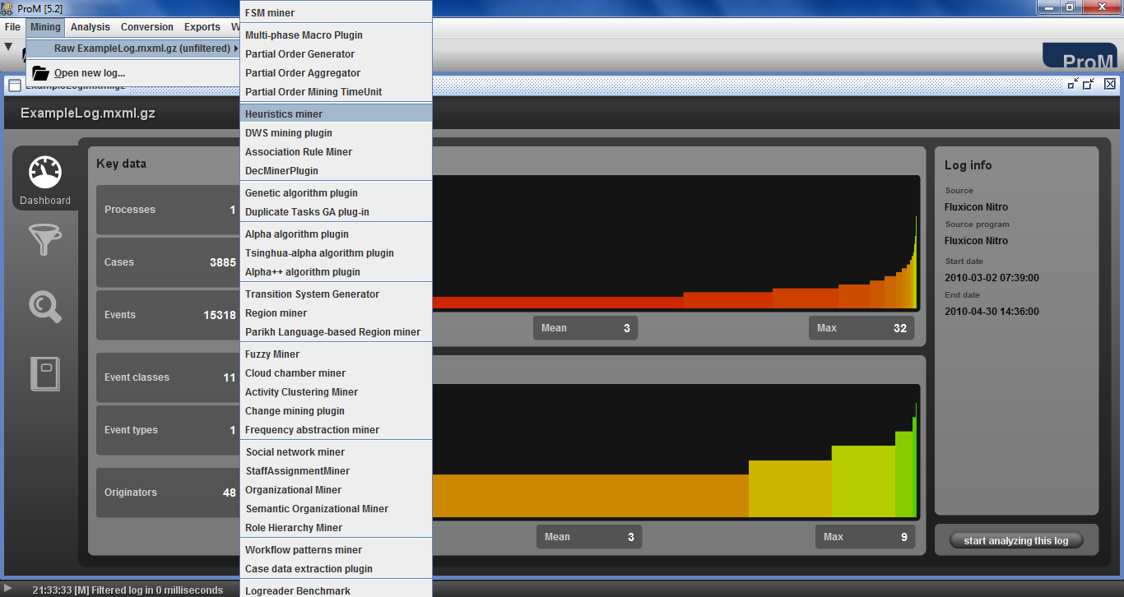
Discover Process – Different Algorithms are Available
Notes:
The menu Mining provides the mining plug-ins. These mining plug-ins mainly focus on discovering information about the control-flow perspective of process models or the social network in the log.
The menu Analysis gives access to different kinds of analysis plug-ins for opened logs, imported models and/or mined models.
The menu Conversion provides the plug-ins that translate between the different notations supported by ProM.
The menu Exports has the plug-ins to export the mined results, etc.

Slide 28
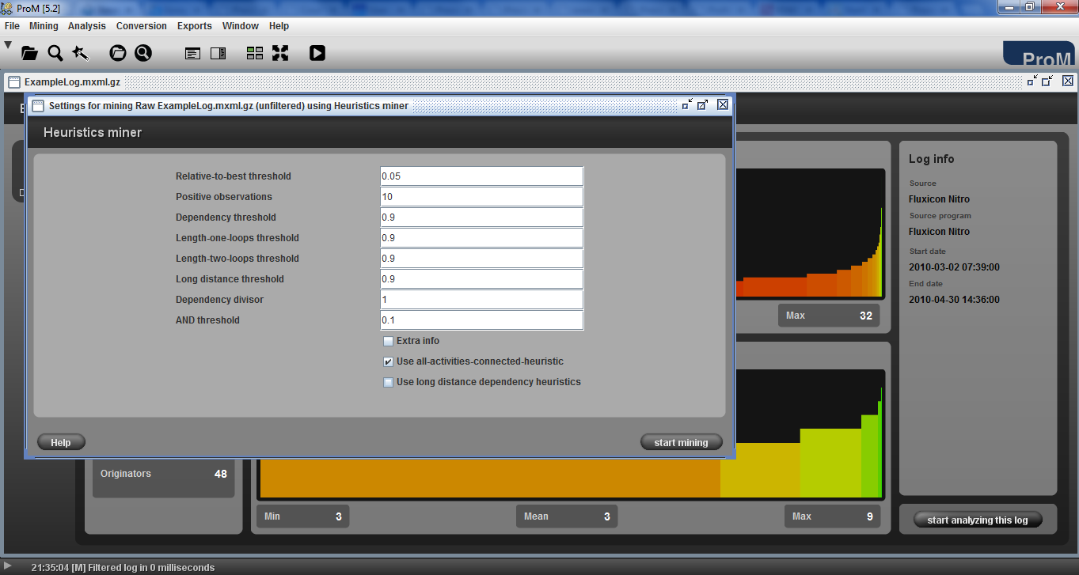
Heuristics Miner

Slide 29
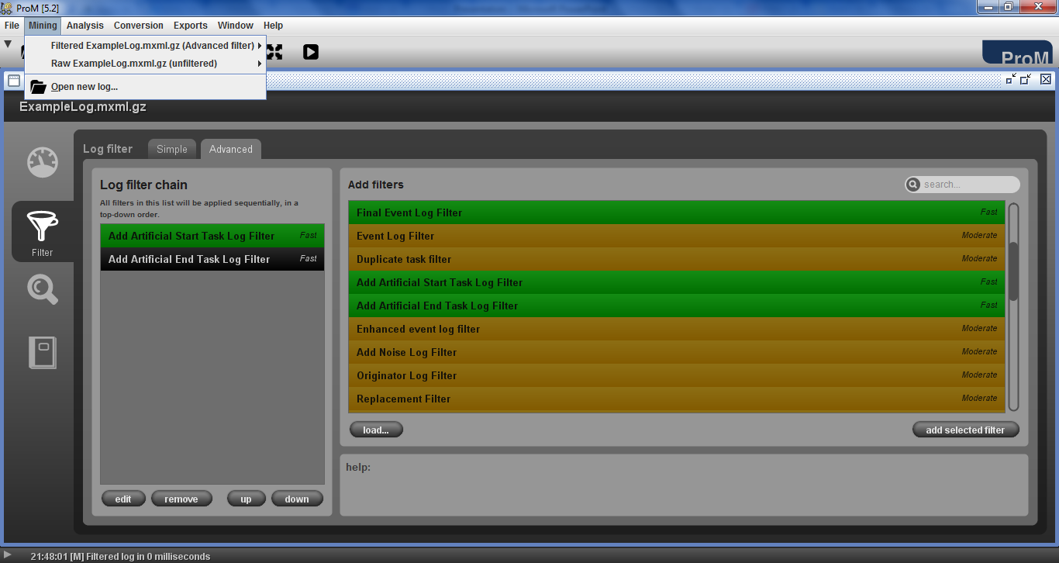
Add Start and End Nodes

Slide 30
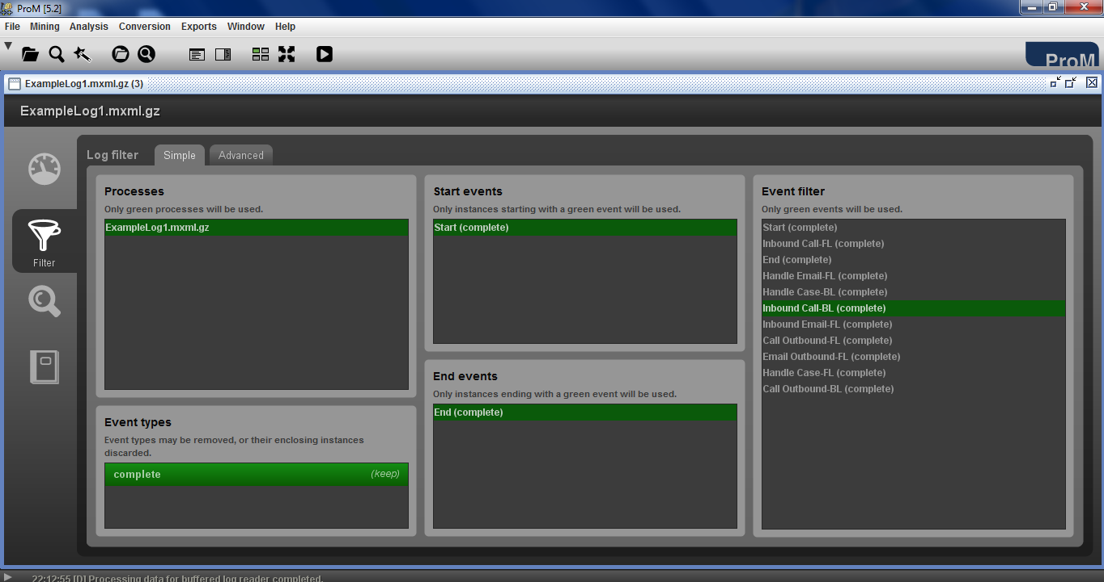
Discover Process

Slide 31
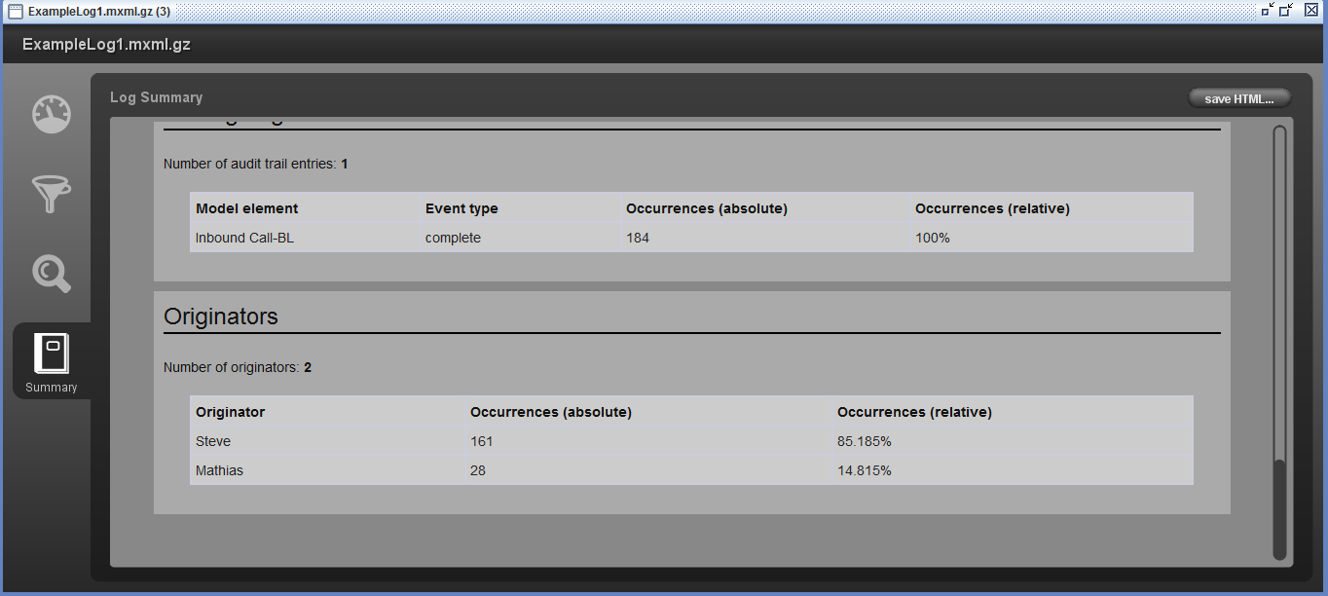
Discover Process

Slide 32
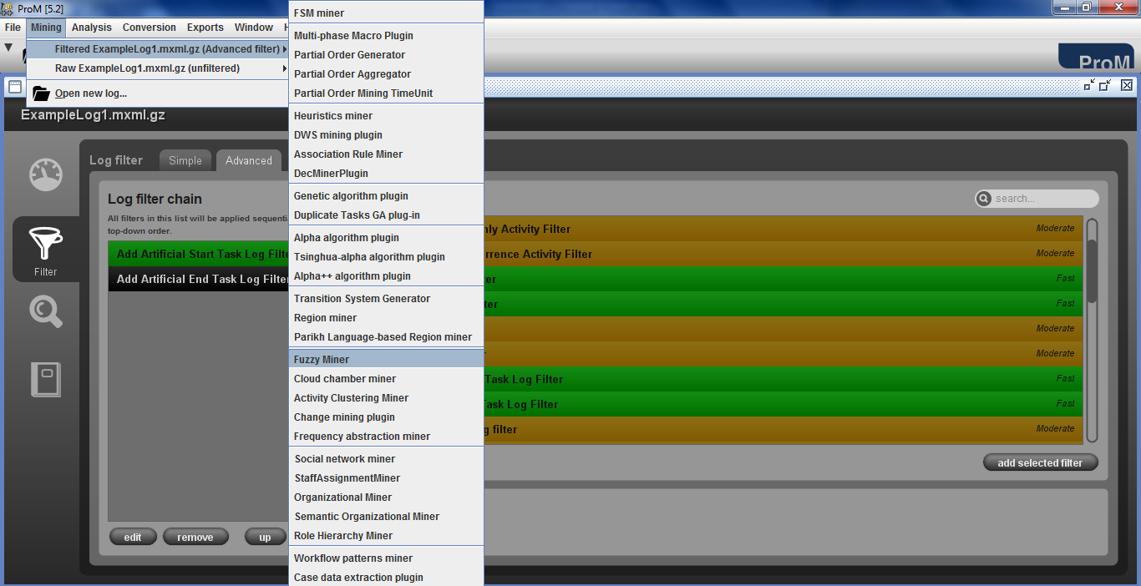
Tune Level of Detail

Slide 33
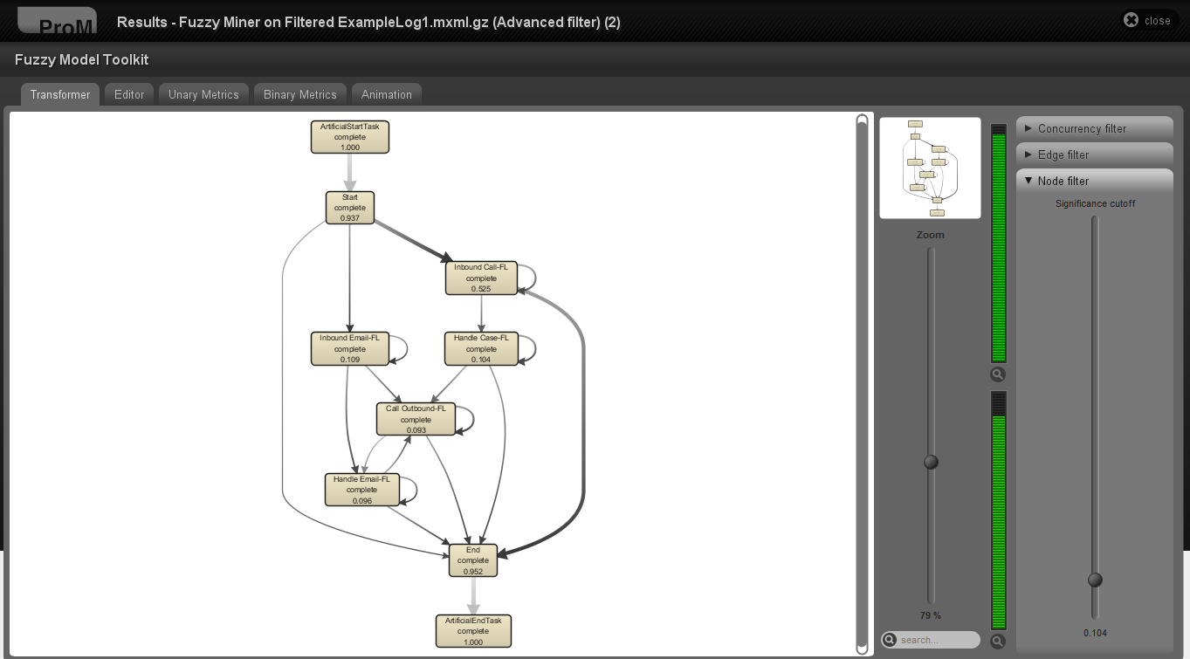
Tune Level of Detail

Slide 34
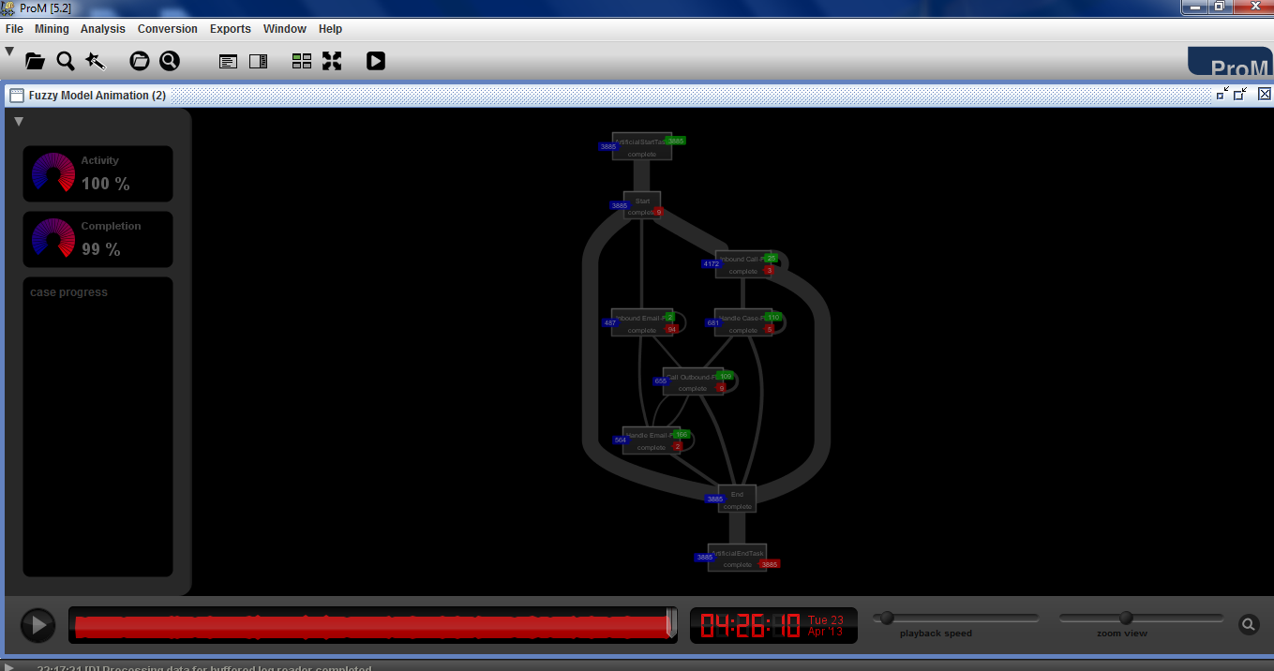
Animate Process

Slide 35
Process Mining Exercise
1. Download DISCO from http://www.fluxicon.com. Spend some time playing around in the “Sandbox” to get familiar with the software (not for grade).
Homework Exercise
Import the tiny event log in the accompanying “TedExampleProcessLog” Excel file. Identify the Case, Activity(=Operation), Timestamp and Resource(=Agent) columns. Run Disco.
a. Comment on the process map (include the map in your answer). Is there a problem in the process? Check that the map and related statistics are correct.
b. Produce a map showing the interaction between the resources (Helen and George) by identifying the Agent column as the activity (a trick). Include the map in your answer. Comment on the resulting resource-to-resource map.
2. Read the accompanying paper, “A Field Study on the Use of Process Mining of Event Logs as an Analytical Procedure in Auditing.” The authors found several issues in the discovered process map that might indicate potential fraud. Briefly (in 2 or 3 lines) describe one of these situations. What is the “separation of duties” (or “four-eyes” principle)?

Slide 36
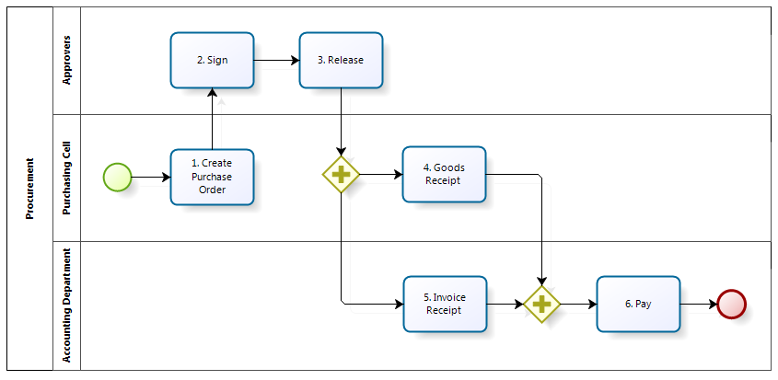
Auditing Case Study
FIGURE 1: Flow chart of the designed procurement process - an illustration of the procurement process in an ideal setting without any changes once the purchase order is created or any alterations made to the control system.

Slide 37
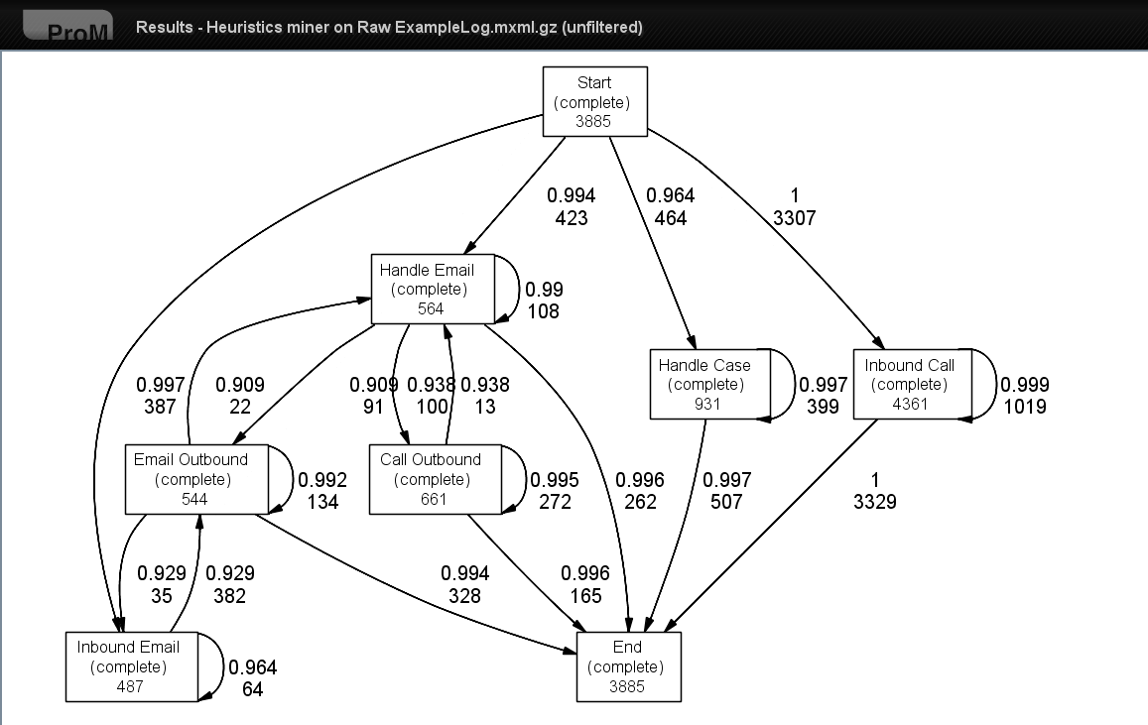
Resulting Process Model
Notes:
The graphical mining result is depicted here.
First a short explanation of the graphical representation. The square boxes are the tasks; the arcs indicate the dependency between tasks. The number in the event box indicates the number of times the tasks in that box is performed (i.e. the event log contains 3685 occurrences of task Start). The number on the arcs indicates the number of times the connection is used (i.e. the numbers 387 and 423 on the Start to Inbound Email and Start to Handle Email arc indicates that Task Start is 387 times followed by task Inbound Email and 423 times by task Handle Email. Above the frequency information, the dependency information measure indicates how certain we are that there is a dependency relation between two activities. A high value (close to 1.0) means that we are very sure that there is a dependency relation between the connected tasks.

Slide 38
Event Frequencies
Activity | Absolute Frequency | Frequency Activity/ Frequency ‘Create PO’
1.Create PO | 26185 | 1.0000
2. Sign | 25648 | 0.9795
3. Release | 28748 | 1.0979
4. GR | 24724 | 0.9442
5. IR | 29255 | 1.1172
6. Pay | 31817 | 1.2151
Change Line | 15468 | 0.5907
TABLE 1: Frequency of activities in the event log – absolute frequency and relative frequency in relation to frequency of ‘Create PO’ activity showing that not all activities takes place only once as indicated in the designed process.

Slide 39
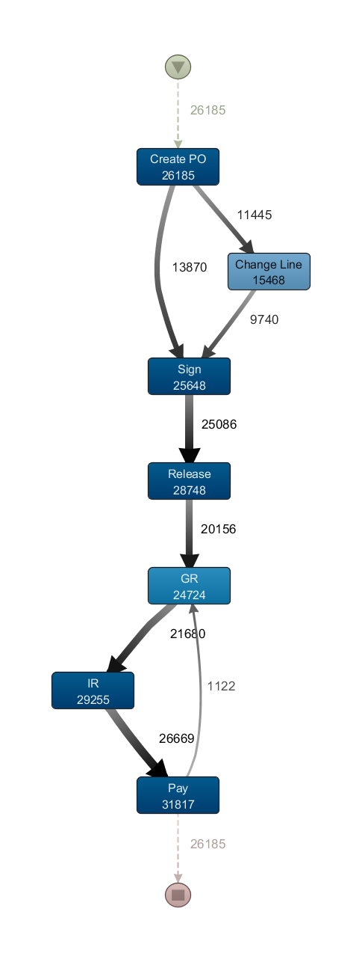
Simplified Map
FIGURE 2: Output of fuzzy miner with default settings to uncover core processes - an illustration of the most commonly occurring steps actually taking place in the procurement process.

Slide 40
A More Detailed Map
FIGURE 3: Output of fuzzy miner with lower threshold setting to reveal less-frequent flows - an illustration of both the most commonly occurring steps taking place in the procurement process as well as less frequent flows.

Slide 41
Table 2 - Frequent Patterns
 |  | Pattern Frequency |  | Cum. total | Paid Value | Throughput time (days)
Pattern | Sequence | # | % | % | Euros | avg | min | max | st.dev
1 | Create PO → Sign → Release → GR → IR → Pay | 11608 | 44.3% | 44.3% | 7 634 968.47 | 27.78 | 1 | 334 | 20.05
2 | Create PO → Change Line → Sign → Release → GR → IR → Pay | 6955 | 26.6% | 70.9% | 8 178 348.22 | 32.33 | 2 | 343 | 57.72
3 | Create PO → Change Line → Release → IR → Pay | 2488 | 9.5% | 80.4% | 504 341.51 | 75.63 | 3 | 344 | 38.99
TABLE 2: Most frequent patterns in the event log illustrating the variety of ways in which the actual procurement process differs from the designed process.

Slide 42
Table 3: Anomalous Sequences:
Sequence | Extra flows | Occurrences | Result
1 | Create PO → Release | 739 | Verification required for omitting Sign
2 | Change Line → Release | 2819 | Verification required for omitting Sign
3 | Sign →GR | 19 | Further investigation → OK
4 | Release → IR | 5006 | Verification required on GR indicator
5 | Release → Pay | 312 | Verification required on GR indicator and IR
6 | Pay → IR | 499 | Verification required on IR
TABLE 3: Results of explicit checks on the extra edges in the Fuzzy Miner output illustrating the frequency with which certain anomalous sequences occur

Slide 43
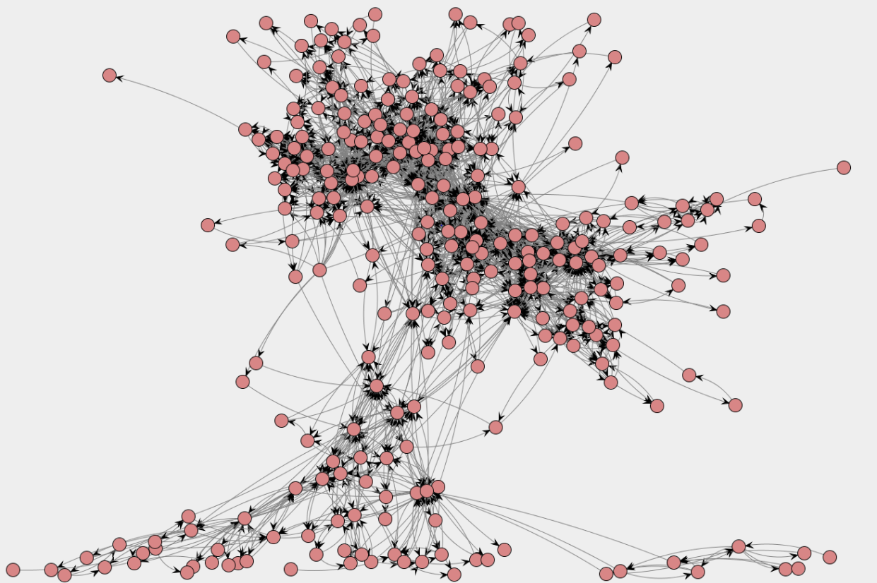
Social Network 1
FIGURE 4: Social network of all originators in the procurement process - an illustration of the degree of interaction between the 272 distinct individuals taking part in the process.

Slide 44
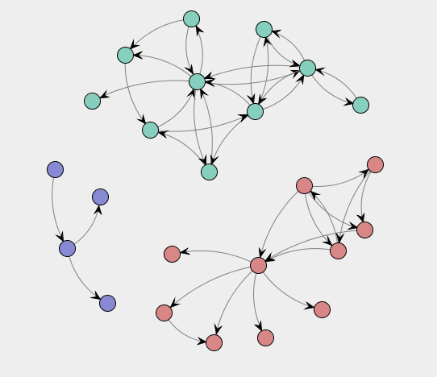
Social Network 2
FIGURE 5: Social network of 175 cases by three individuals violating SOD controls on Release and GR illustrating who else they interacted with while undertaking those transactions.

Slide 45
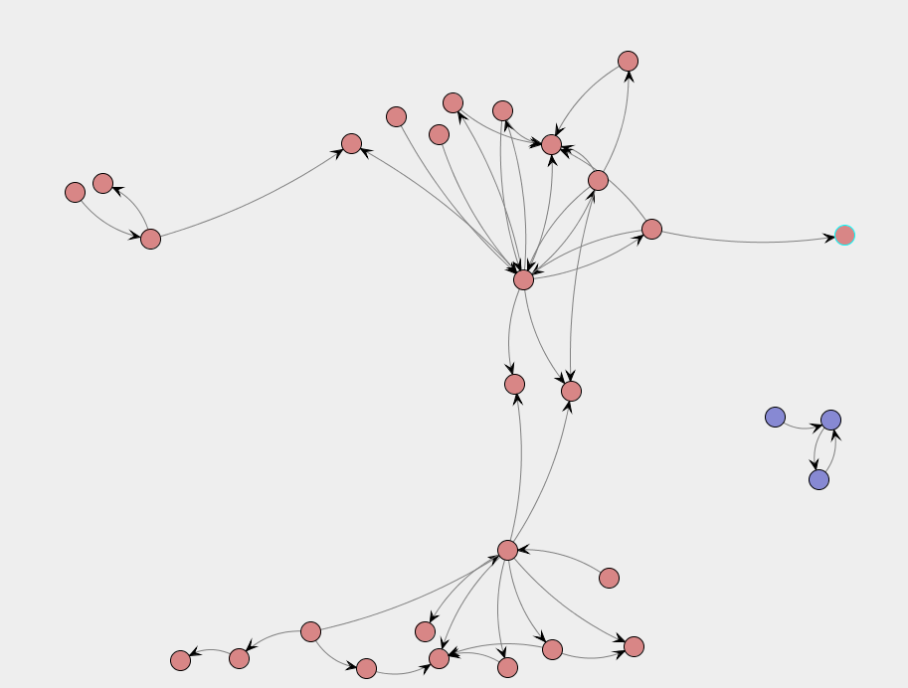
Social Network 3
FIGURE 6: Social network of the 742 cases without Sign and in violation of controls, illustrating which individuals were involved in those transactions and who else they interacted with.

